Slide 1
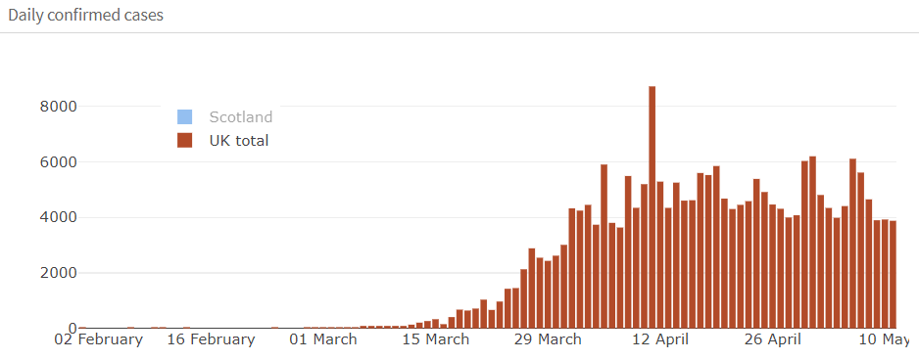
Timeline of COVID-19 Modelling in the UK
Question 1: How fast can this spread?
Understanding the initial stages of the outbreak and characteristics of the disease.
Question 2: How can we reduce the transmission and “flatten the curve”?
Find ways to reduce peak deaths/cases and prevent overwhelming the NHS.
Question 3: What is the exit strategy?
Find ways to prevent a second peak and protect vulnerable populations.
Q3
23rd March - Lockdown
Q2
https://smazeri.shinyapps.io/Covid19_Scotland/#section-scotland-uk
Q1
Notes:
LSHTM – Modelling is dirven by thew question we need to answer and over the course of the outbreak those questions have changed to reflect our current situation.

Slide 2
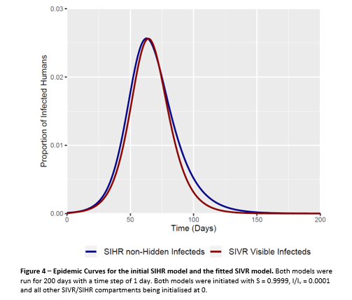
Question 1: How fast can this spread?
Initial focus on the characteristics of the virus
R₀
Doubling time
Person-to-person transmission?
Can this be contained?
Simple Modelling to explore unmitigated outbreak
SIR models
Exponential growth models (a bit flawed)
Spatial models – to identify risk of further spread from China

Slide 3
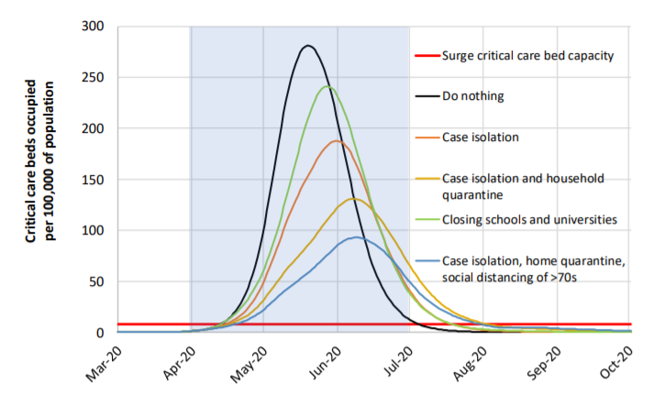
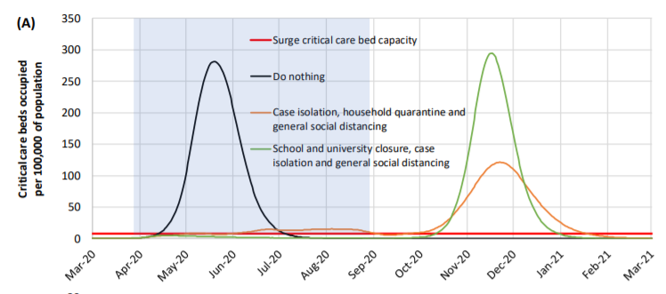
Question 2: How can we reduce the spread and flatten the peak?
Mitigation
How do we flatten the peak and reduce transmission?
How can we reduce the load on the NHS?
Possible Intervention Strategies
School closures
Travel restrictions
Physical distancing
Self-isolation and household quarantine
Contact tracing (manual and app based)
Mass testing
Argument of Suppression vs Mitigation
https://www.imperial.ac.uk/mrc-global-infectious-disease-analysis/covid-19/covid-19-reports/
Suppression

Slide 4
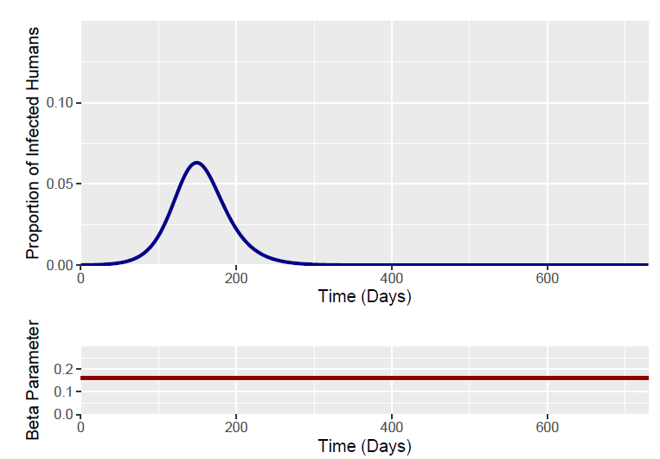
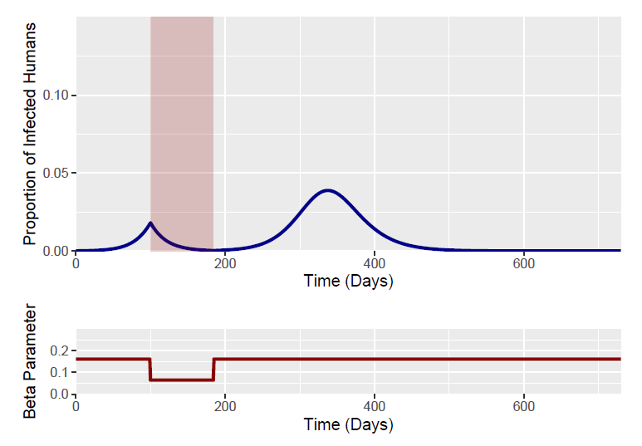
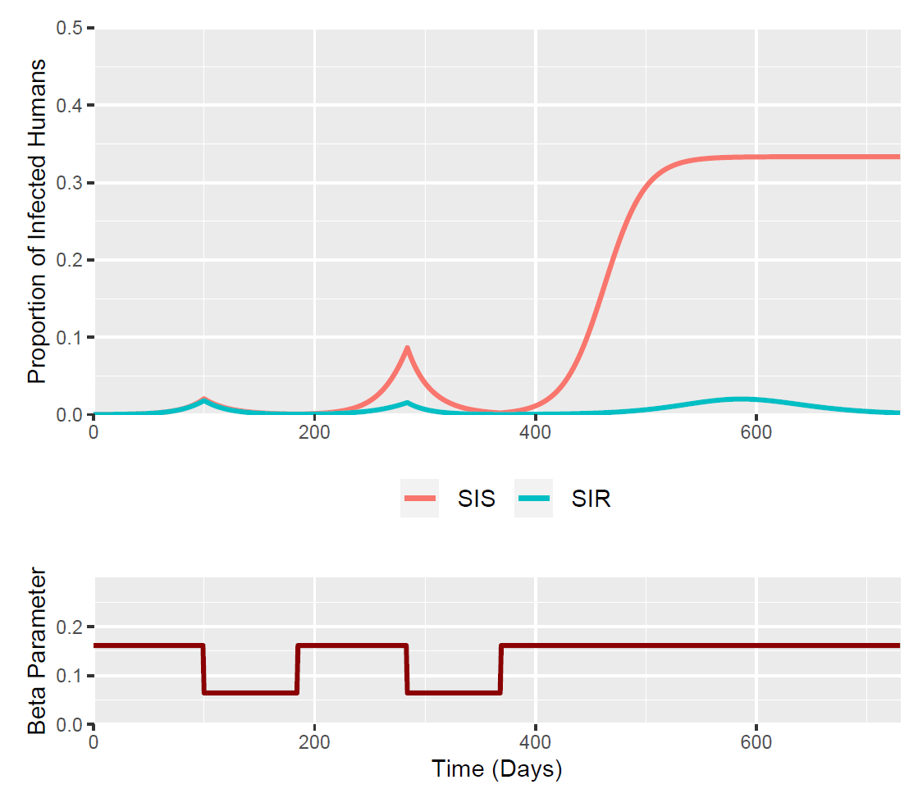
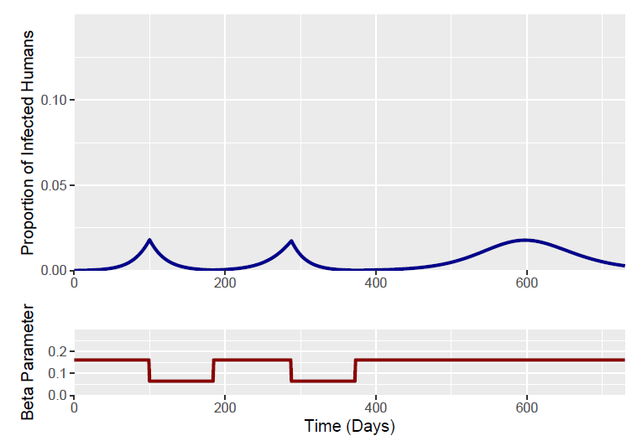
Question 2: How can we reduce the spread and flatten the peak?
Before – 1 Intervention
In Edinburgh….
Looked at simple models to assess the effect of intervention timing and magnitude.
Optimal timing and the effect of multiple interventions
Effect on Model with no Immunity
After – 2 Interventions
Notes:
Bram recently described the effectiveness of social distancing measures (SDM) on COVID-19 epidemic curves
Multiple SDM interventions can suppress multiple epidemic peaks – occurring after lifting previous SDM interventions.

Slide 5

Question 3: What is the exit strategy?
How can we prevent a second peak?
How can we protect the vulnerable population?
Possible Exit Strategies
Continued Lockdown
Removal of Lockdown
Vaccine
Reliance on Antivirals
Test, Trace and Isolate
Enhanced Shielding
Combinations of the above…
Notes:
Talk though each of these exit strategy suggestions

Slide 6
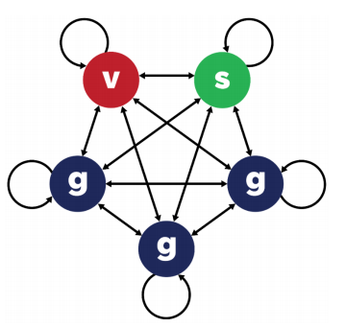
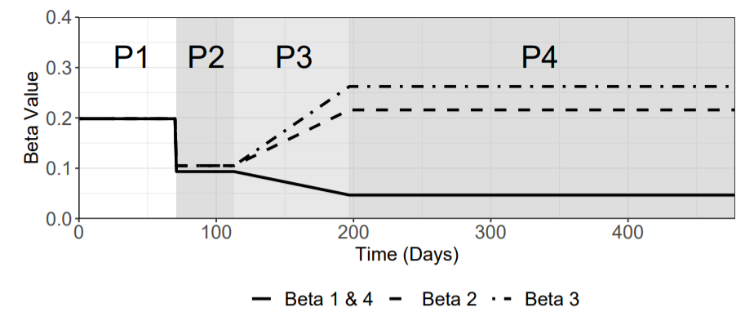
Question 3: What is the exit strategy?
Enhanced Shielding separates population into 3 groups:
Vulnerable (20%)
Shielders (20%)
General (60%)
SIRS Model – Immunity lasts for ~365 days
Specific contact structure between sub-groups…
Notes:
Beta graph and talk through the 4 phases

Slide 7
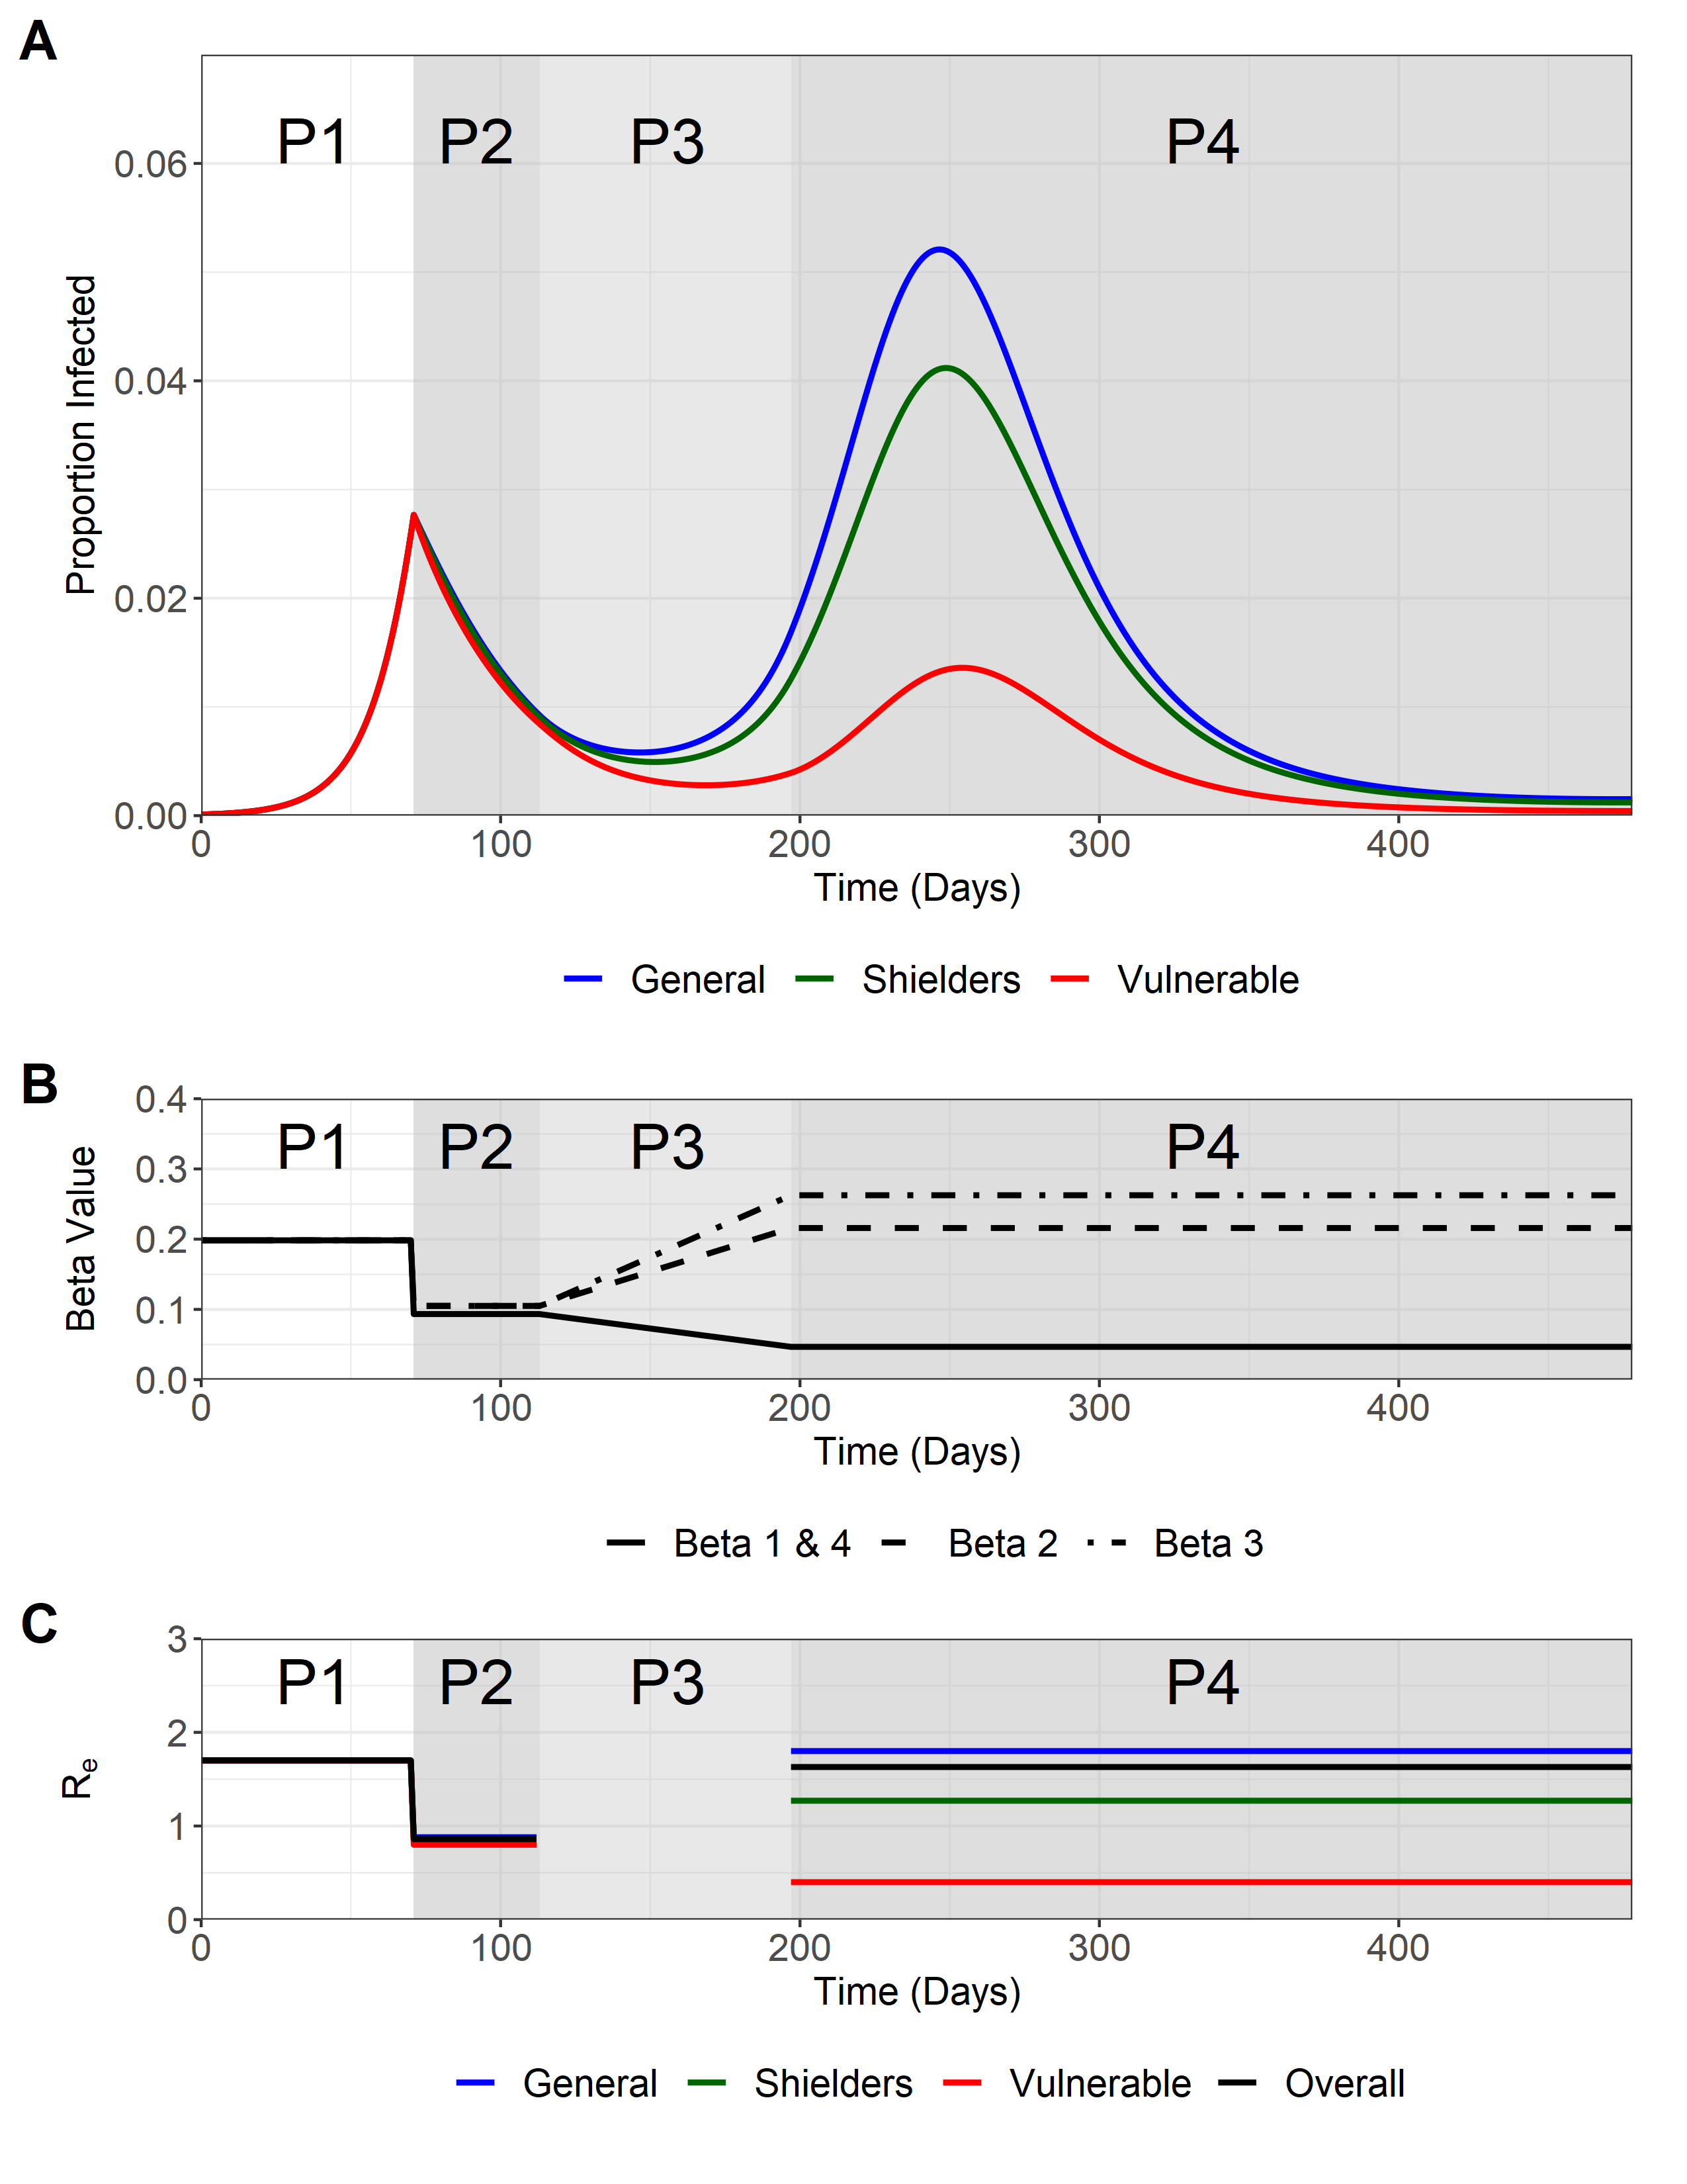
Question 3: What is the exit strategy?
Can prevent large second peak in the most vulnerable population while releasing general/shielders population from lockdown
Notes:
The baseline scenario We modelled a scenario where we shield the vulnerables and allow the general public and to a lesser extent the shielders group to return back to normal
By protecting the vulnerables we can prevent a massive second peak that does not go past the 1st peak.

Slide 8
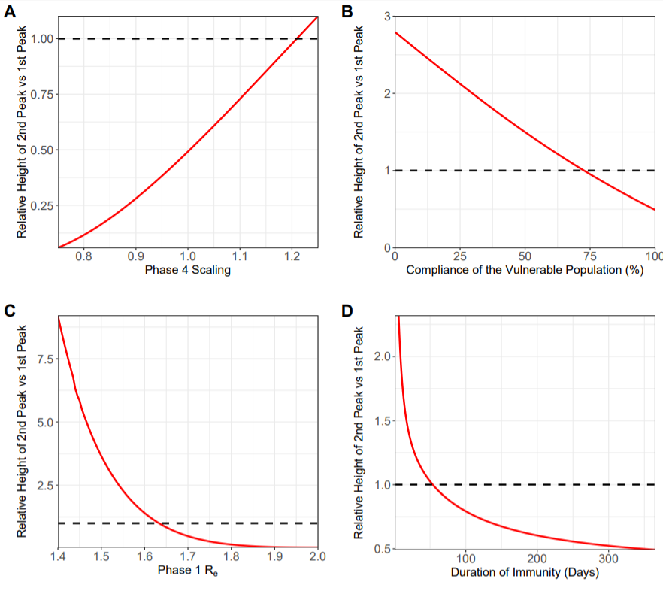
Question 3: What is the exit strategy?
Sensitivity Analysis
Dotted Line – where 1st peak = 2nd Peak for the vulnerable population.
Phase 4 R_{e} (translates into betas)
% compliance of vulnerable population under enhanced shielding
Phase 1 R_{e} (translates into betas)
Duration of immunity (Days)

Slide 9
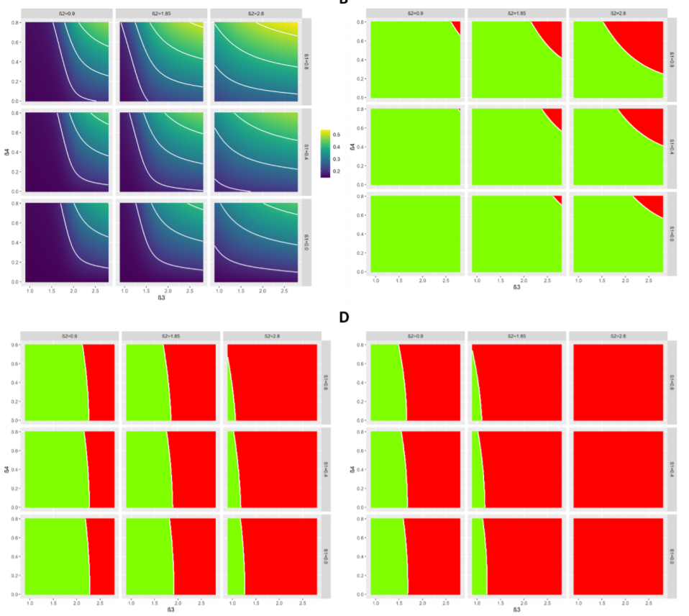
Question 3: What is the exit strategy?
Policy Objective
Future level of infection in the vulnerable population to be kept below the level at the start of lockdown
How easy is it to meet policy objectives?
Increased Relaxation (General)
Decreased
Enhanced Shielding (Vulnerable)

Slide 10
Question 3: What is the exit strategy?
Policy Objective
Future levels of infection in the entire population to be kept below levels at the start of lockdown
How easy is it to meet policy objectives?
Increased Relaxation (General)
Decreased
Enhanced Shielding (Vulnerable)

Slide 11
Question 3: What is the exit strategy?
Policy Objective
No increase in new numbers of cases or deaths after the start of lockdown (constant decrease in cases from lockdown start)
How easy is it to meet policy objectives?
Most red - where relaxation is highest and shielding is lowest
Harder to meet policy objectives when objectives are more restrictive
Increased Relaxation (General)
Decreased
Enhanced Shielding (Vulnerable)

Slide 12
Question 3: What is the exit strategy?
Enhanced shielding is a policy option that could:
Release general public from lockdown
Provide safety for vulnerable populations and prevent large number of deaths/cases
Caveats
Sensitive to a number of model inputs (contact structure between populations)
Behavioural and mental health effects of shielding unknown
Virus + Disease have not been fully characterised
This is not a silver bullet!
Combine with other approaches

Slide 13
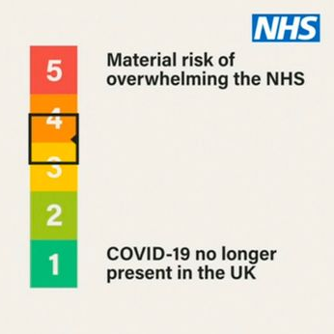

Future of COVID Modelling
What are the next questions for modelling?
Based on the new government policy what is the projected course of the outbreak?
What is the impact of vaccination?
Economic impact of COVID-19?
How will COVID-19 affect LMIC?
What could we have done better? (retrospective analysis with better data)
Effects of COVID-19 on other diseases (TB, routine vaccination etc).
Continued monitoring of the “R” number
EpiEstim Package (https://cran.r-project.org/web/packages/EpiEstim/index.html)

